Slide 1

Analyzing Social Distancing During the COVID-19 Pandemic
Vanessa Tang, Sang-Jyh Lin, Sangseok Lee, Julio Portella

Slide 2


Provided Hashtags and Keywords
#socialdistance
#flattenthecurve
#stayhome
#stayhomestaysafe
#lockdown
#quarantinelife
#stayhomesavelives
#takeresponsibility
#breakthechain
Hand sanitizer
Hydroxychloroquine
Quarantine
Restaurant
Netflix

Slide 3
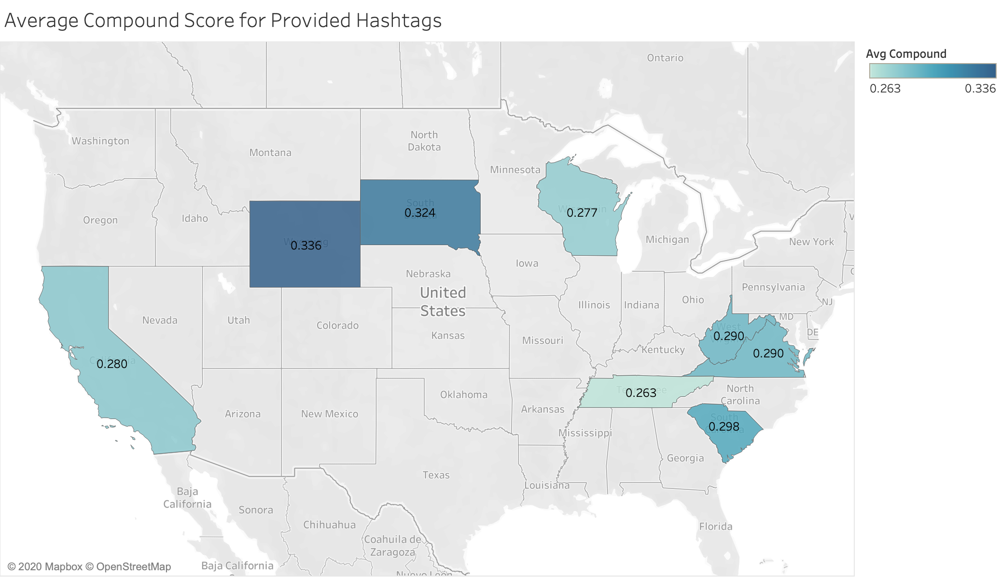
Twitter Sentiment Analysis on Provided Hashtags

Slide 4
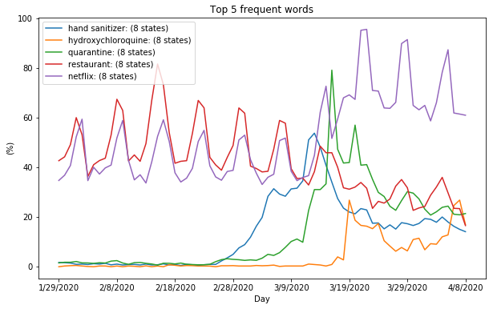
Google Trends on Provided Keywords

Slide 5
Extra Keywords and Hashtags
Bread
Delivery
Zoom
Unemployment

Slide 6
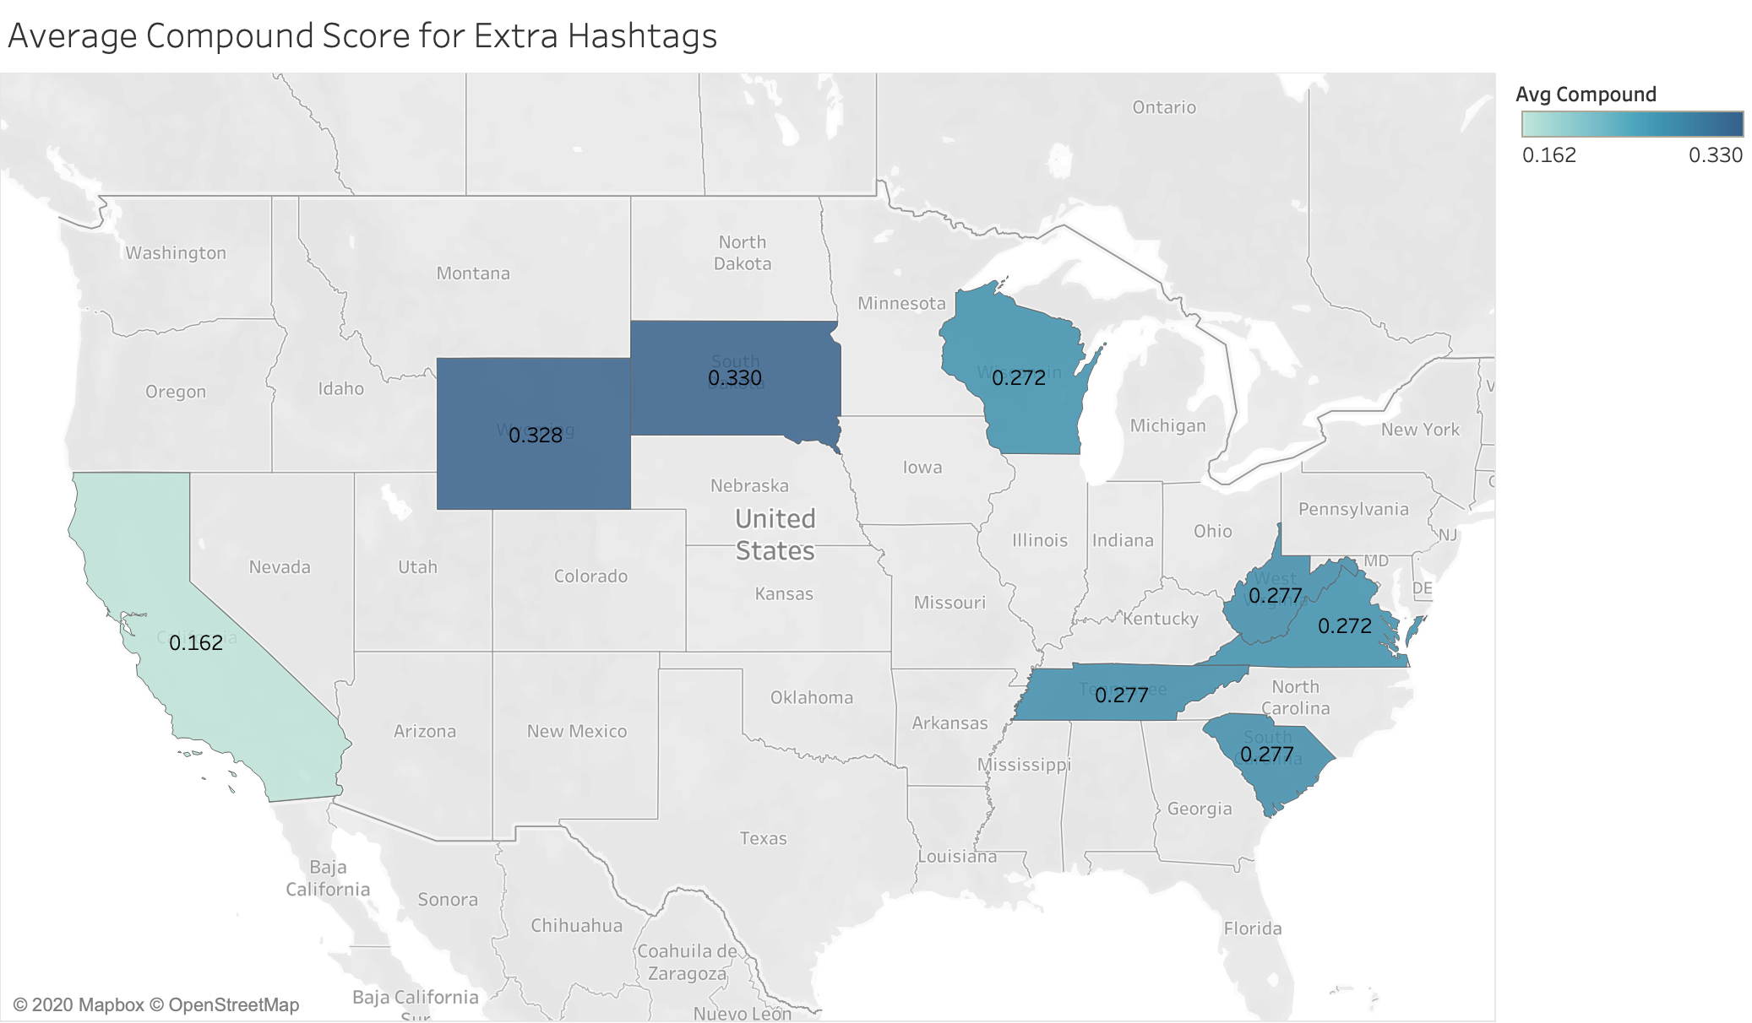
Twitter Sentiment Analysis on Extra Hashtags

Slide 7
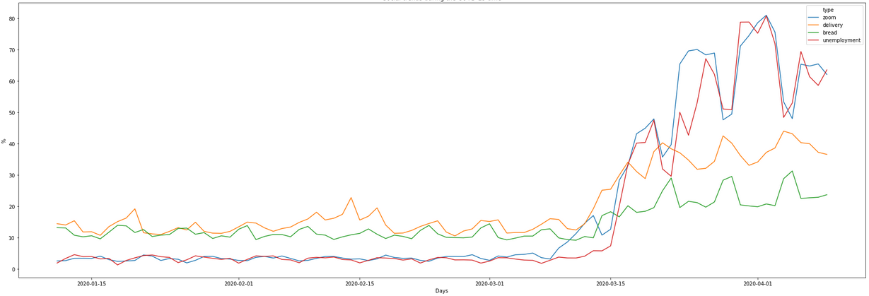
Google Trends on Extra Keywords

Slide 8

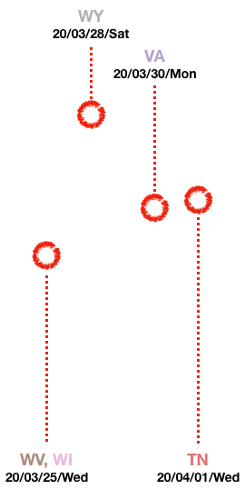
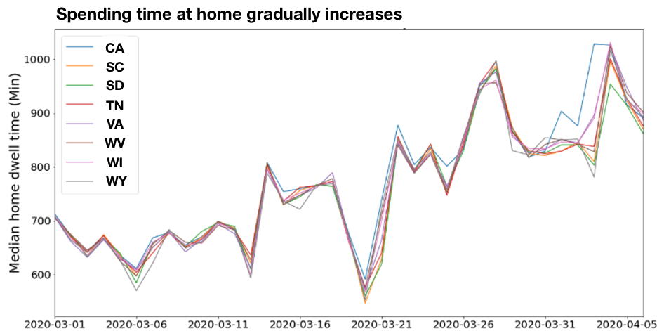
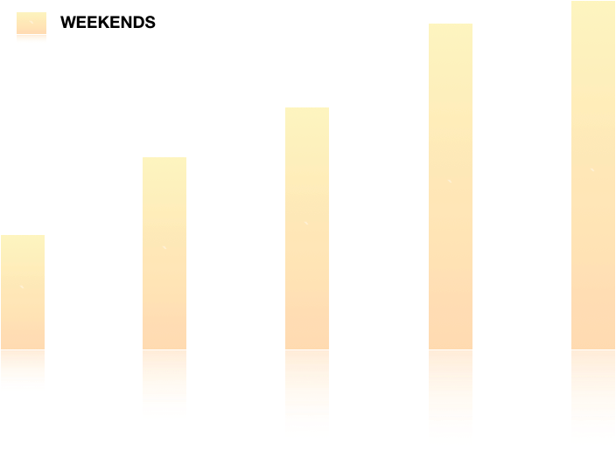
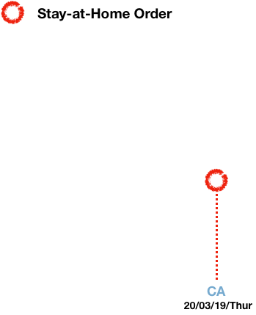

SafeGraph Data: Home Dwell Time
Notes:
This is a home-dwelling time trend in 8 states from Safegraph data. Y-axis is median home dwelling time and x-axis is a date since March. Generally, it looks like people spend more time in house as time went on.
To see the effect of ‘stay-at-home’ order, I marked like this(click) with a red circle. so CA was the first stay home order state among 8 states. (click) This yellow bar is weekends mark. and it seems like people in CA are trying to spend more time in their house even during weekdays(click) due to stay-at-home order. here are other stay home order date. (click)

Slide 9
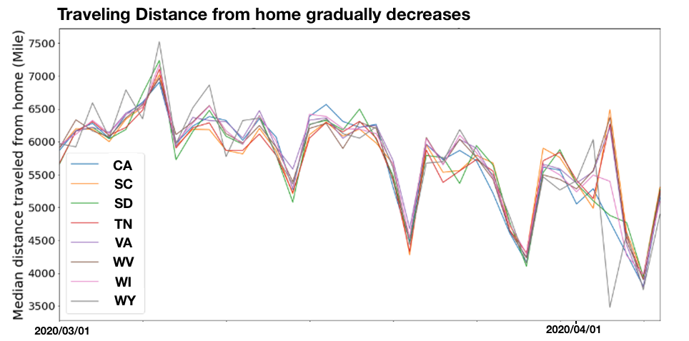
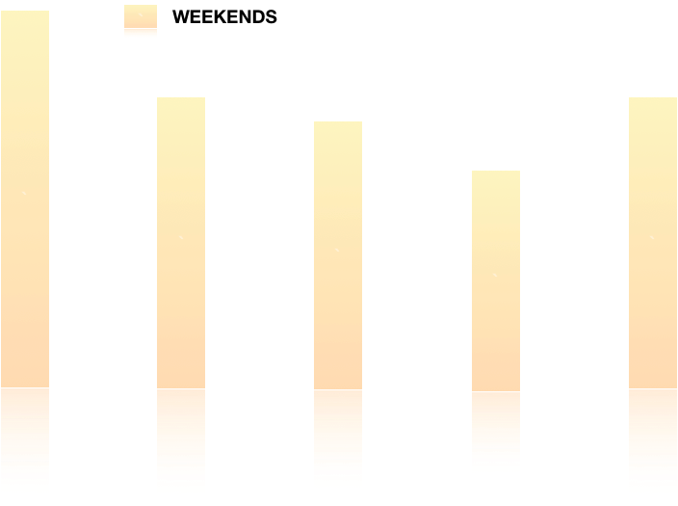
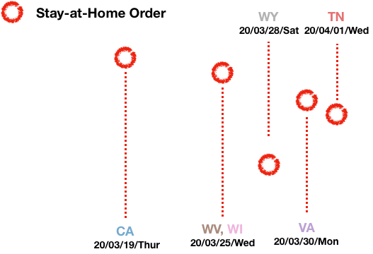
SafeGraph Data: Traveling Distance
Notes:
On the other hand, this graph looks decreasing. This graph is a traveling distance trend from home, so basically this decreasing trend shows that people spend less time traveling from home. If you look at the First weekends of March, it has the highest traveling distance point . As stay-at-home order(click) was made in each state, traveling distance keeps decreasing specially during the weekends(click) it sharply goes down compared to weekdays. In contrast, travel distance during weekdays, overall it slightly decreases but not a lot of change.

Slide 10
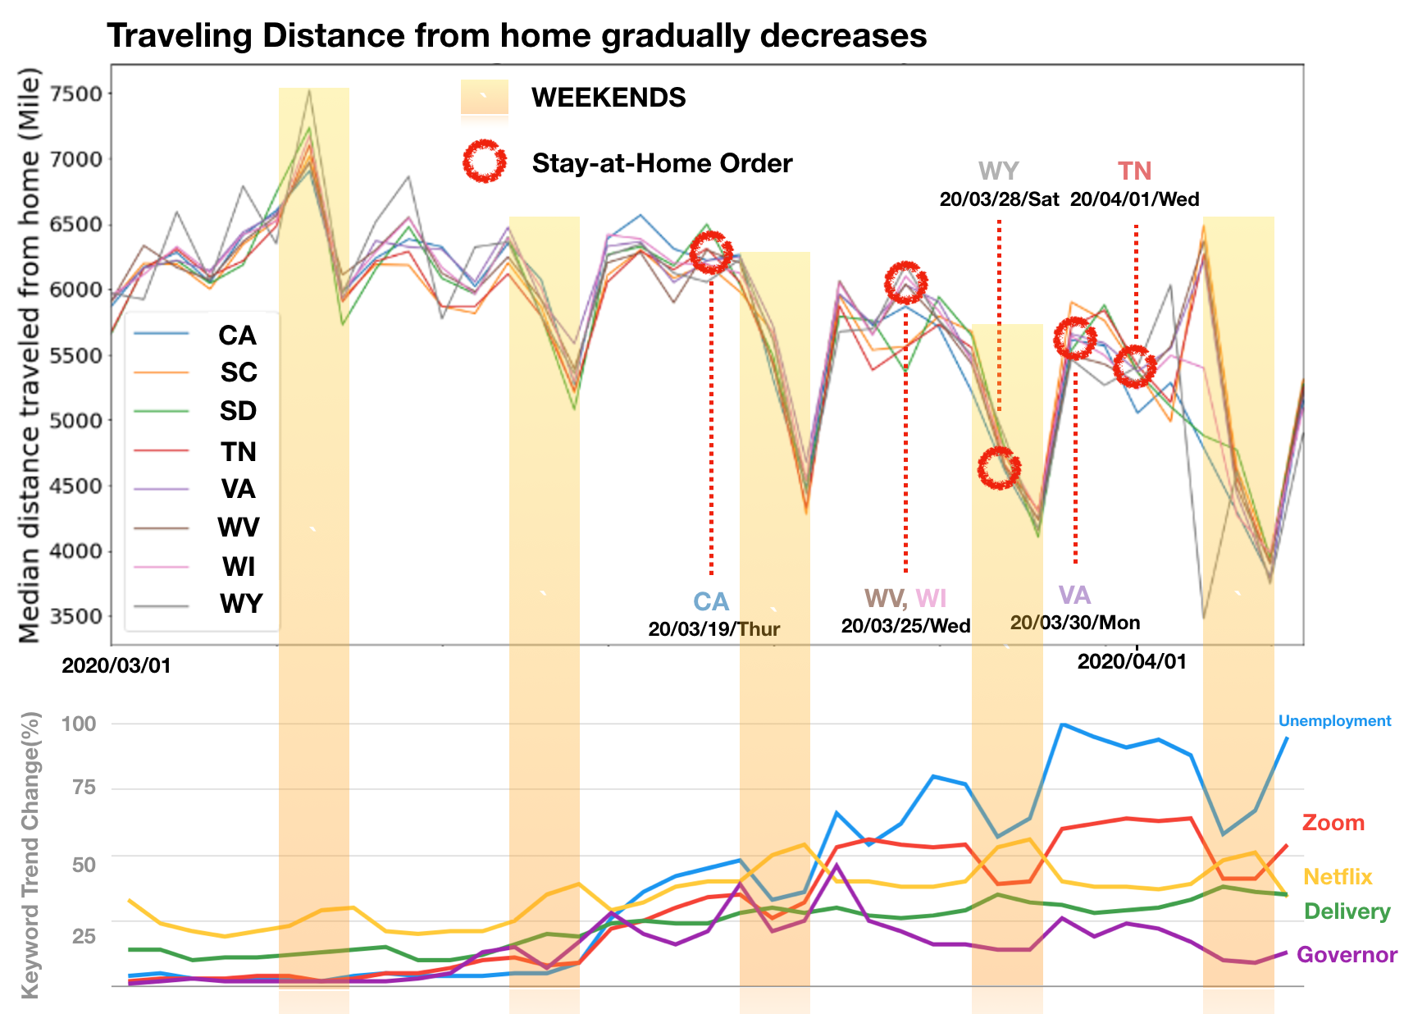
Summary
Increasing trends
zoom, netflix
home dwell time
unemployment
Decreasing trends
travel distance from home
Notes:
To summarize, as we saw from google trends, more and more people search netflix and zoom over time. Unemployment and delivery are also keywords that show increasing trends. From Safegraph data, we can see the same increasing trend in home dwelling time. On the other hand, travel distance from home decreased over time.

Slide 11
Future Work
Get more Twitter data with Premium API
Spend more money on Google Ads
Use other social networks API like Reddit or FB comments
Relate trends to COVID-19 patterns in states
Causal relationship before and after ‘state-at-home’ order
Notes:
For the future work,
we want to obtain more twitter data wiht premium API and spend more money on Google ads. ALso, other social networks like Reddit or FB comments would be good sources to analyze.

